Slide 1

A Non-Repudiation Protocol
Group 7: Andrea Munarin, Francesco Perencin, Simone Jovon
Notes:
Presentations and good afternoon everyone

Slide 2
Introduction
In this presentation:
A non-repudiation protocol
PEPA models
Derivation graphs
Markov chain and Performance analysis
PEPA Eclipse Plug-in

Slide 3
Protocols
General Definition
“The official procedure or system of rules governing affairs of state or diplomatic occasions.”
Computing Definition
“A set of rules governing the exchange or transmission of data between devices.”

Slide 4
Non-repudiation
“Mallory buys a cell phone for $100, writes a paper cheque as payment, and signs the cheque with a pen. Later, she finds that she can't afford it, and claims that the cheque is a forgery. The signature guarantees that only Mallory could have signed the cheque, and so Mallory's bank must pay the cheque. This is non-repudiation; Mallory cannot repudiate the cheque.”
Notes:
More hard to break digital signature
Assurance that the sender of information is provided with proof of delivery and the recipient is provided with proof of the sender’s identity, so neither can later deny having processed the information.

Slide 5
Zhou&Gollmann Model — Terminology 1
M: Message
L: a unique label chosen by TTP to identify the message M
T_{s}: the time that TTP received A’s submission
T_{d}: the time that TTP delivered and available to B
Notes:
Remember to first define A,B and TTP

Slide 6
Zhou&Gollmann Model — Terminology 2
NRO = sS_{A}(f_{NRO}, TTP, B, M)
non-repudiation of origin for M
NRS = sS_{D}(f_{NRS}, A, B, T_{s}, L, NRO)
non- repudiation of submission of M
NRR = sS_{B}(f_{NRR}, TTP, A, L, NRO)
non-repudiation of receiving a message labelled L
NRD = sS_{D}(f_{NRD}, A, B, T_{d}, L, NRR)
non-repudiation of delivery of M

Slide 7
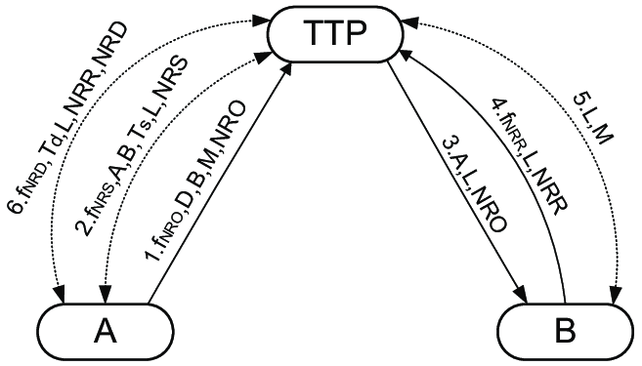
Zhou&Gollmann Model — Representation

Slide 8
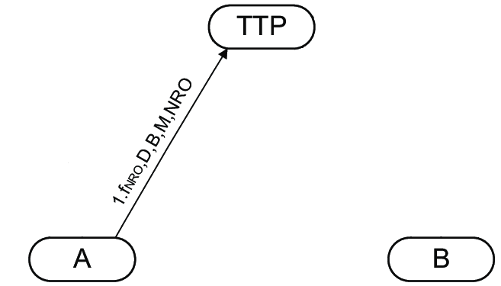
Zhou&Gollmann Model — 1.request
A → TTP f_{NRO}, TTP, B, M, NRO
Notes:
action types

Slide 9
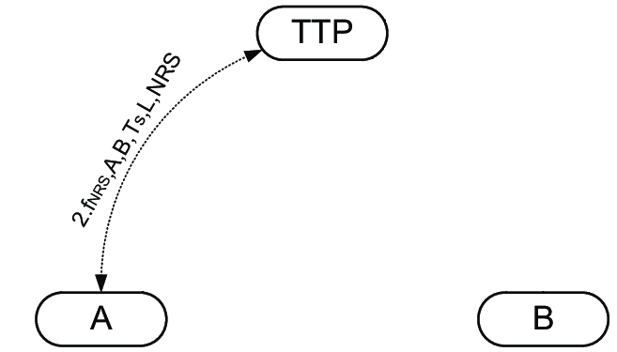
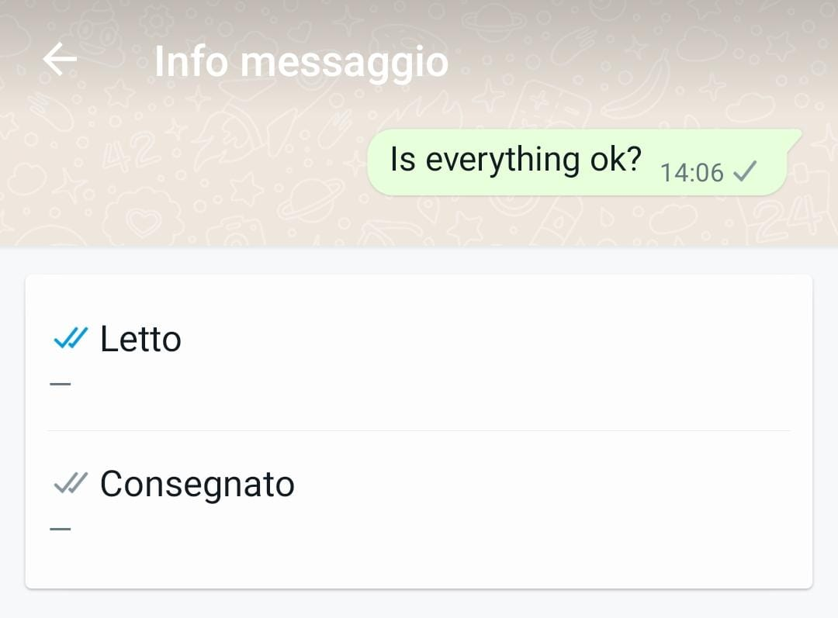
Zhou&Gollmann Model — 2.publish1&getByA1
A ↔ TTP f_{NRS}, A, B, T_{s}, L, NRS

Slide 10
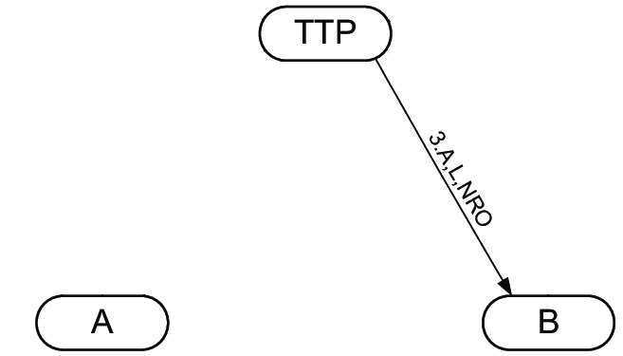
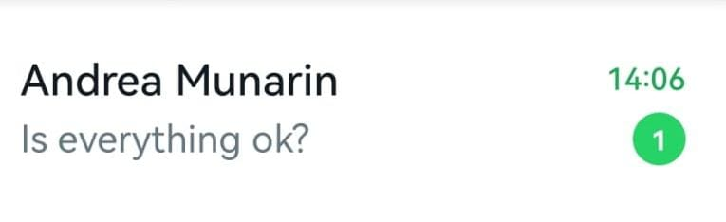
Zhou&Gollmann Model — 3.sendB
TTP → B A, L, NRO

Slide 11
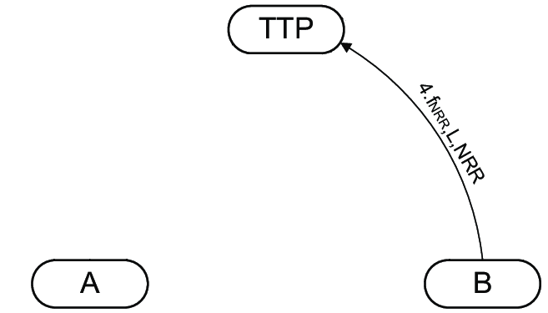
Zhou&Gollmann Model — 4.sendTTP
B → TTP f_{NRR}, L, NRR

Slide 12
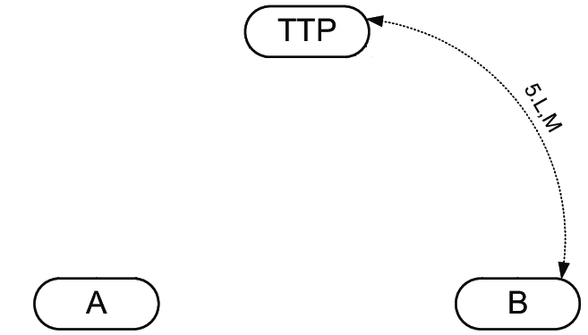
Zhou&Gollmann Model — 5.publish2&getByB
B ↔ TTP L, M

Slide 13
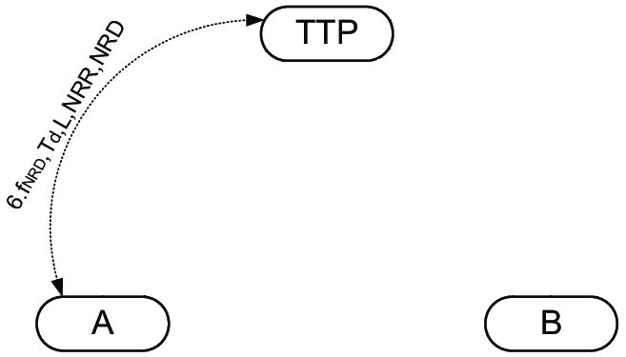
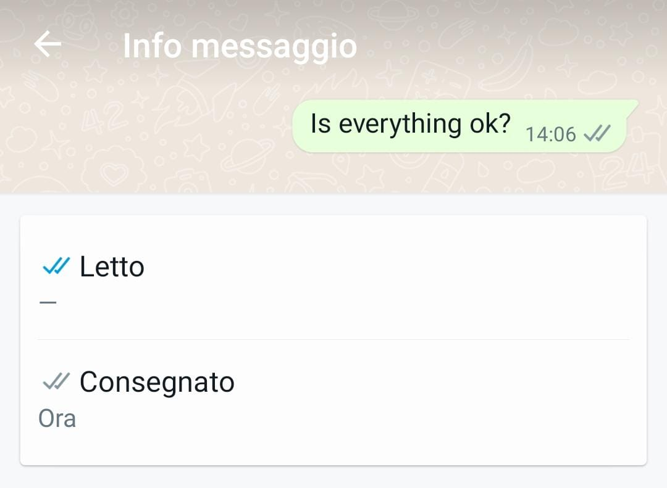
Zhou&Gollmann Model — 6.publish2&getByA2
A ↔ TTP f_{NRD}, T_{d}, L, NRR, NRD

Slide 14
PEPA Model

Slide 15
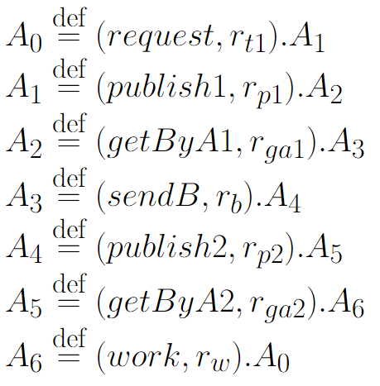
Initial Model — Client A

Slide 16
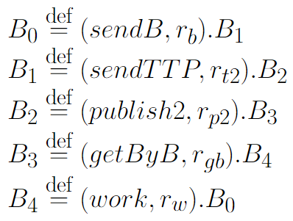
Initial Model — Client B

Slide 17
Initial Model — TTP

Slide 18
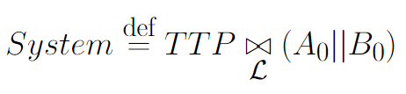

Initial Model — System

Slide 19
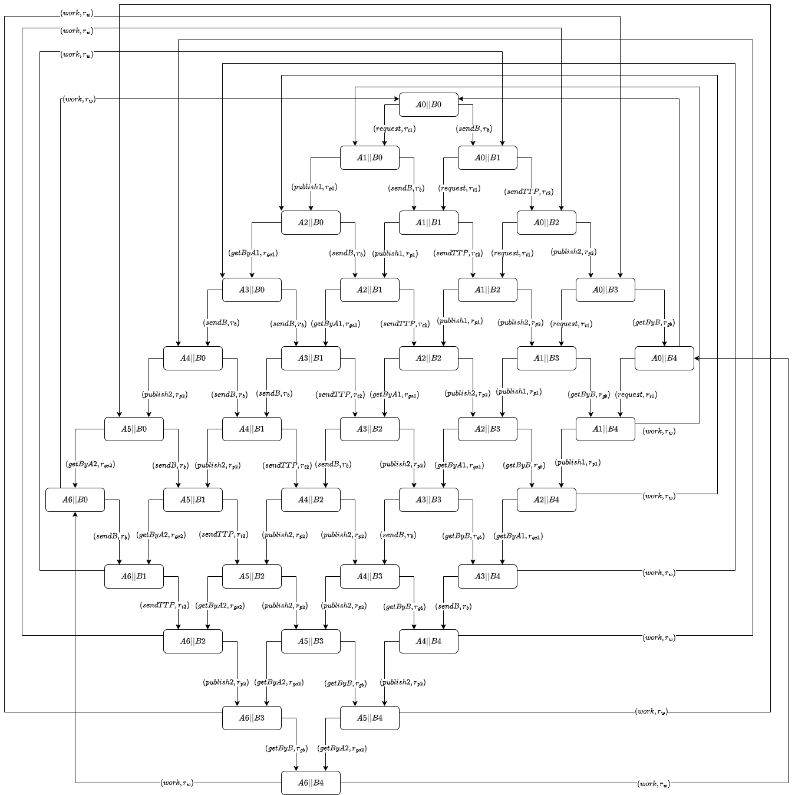
Derivation Graph A||B

Slide 20
Simplified Model

Slide 21
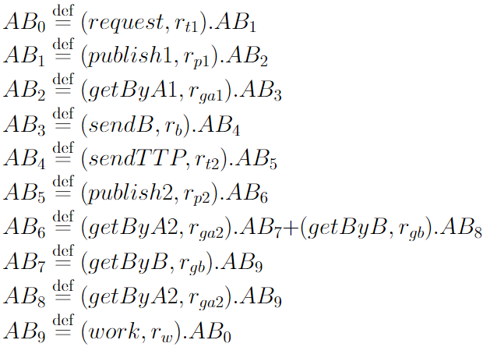
Simplified Model — Clients AB

Slide 22
Simplified Model — TTP

Slide 23

Simplified Model — System

Slide 24
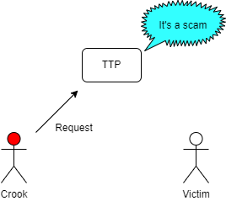
Improved System — Verification
Non-Repudation Protocol might be used by unofficial entities:
User can sign fake contract
TTP must verify the authenticity of contract
If scam is recognized, the procedure has to be stopped

Slide 25
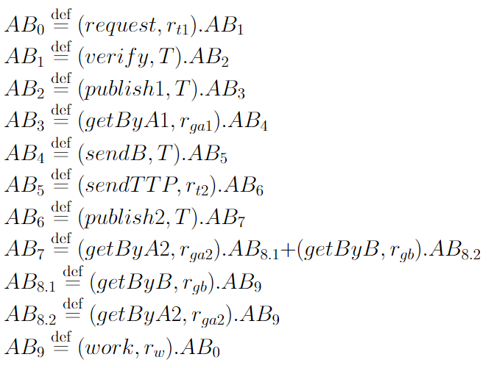
Improved System — Clients AB

Slide 26

Improved System — TTP

Slide 27

Improved System — System

Slide 28
Derivation Graphs

Slide 29
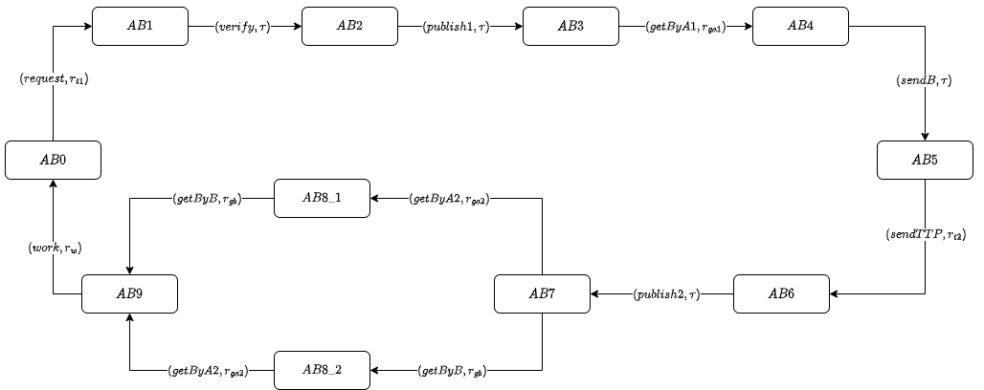
Clients AB

Slide 30
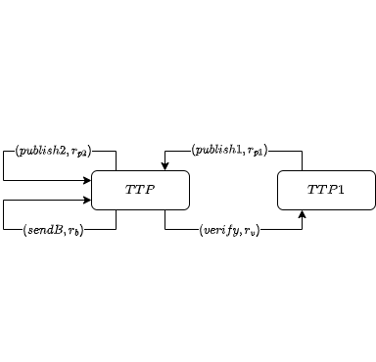
TTP

Slide 31
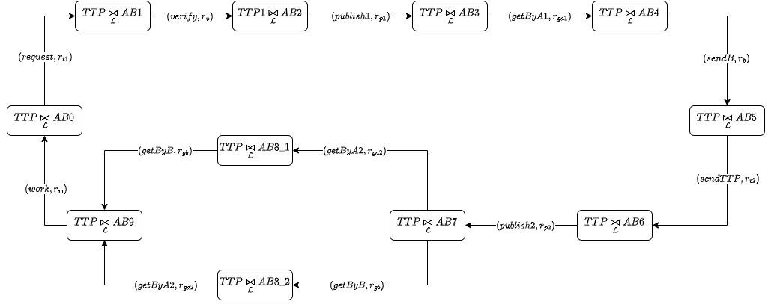
System

Slide 32
Markov Chains and Performance analysis

Slide 33
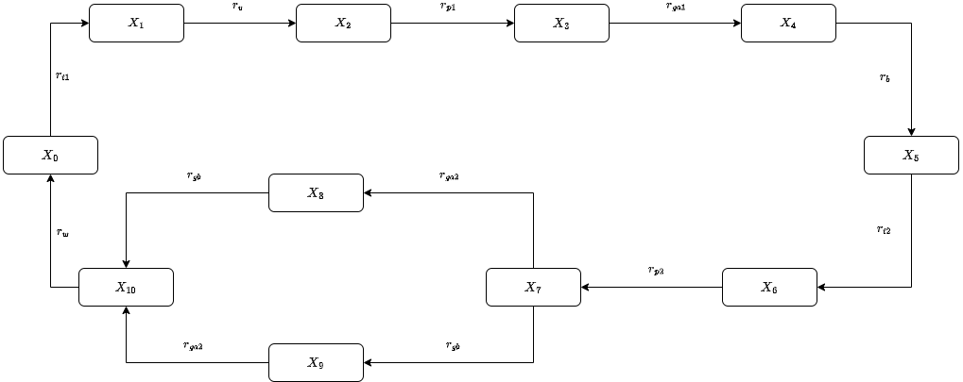
Underlying Markov chain
Notes:
Stochastic Process Markov Property
Time homogeneous
Irreducible
Positive recurrent (ergodic is synonymous)

Slide 34
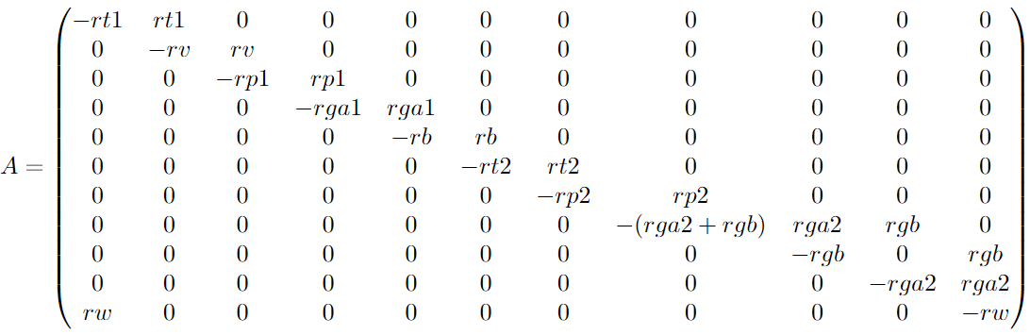
Infinitesimal generator matrix
Notes:
diagonal = -sum of element in the row
element = transition rate

Slide 35
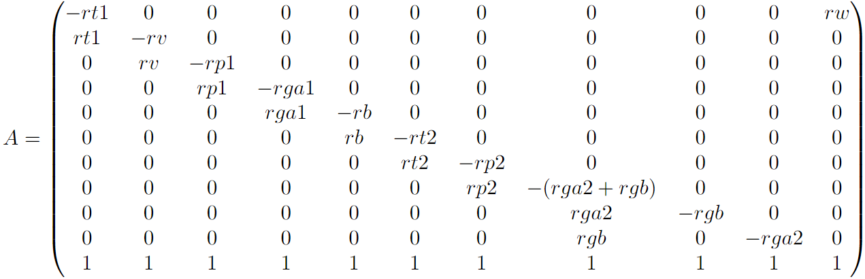
Transpose infinitesimal generator matrix
Notes:
Also add one in the last line to compute steady state

Slide 36
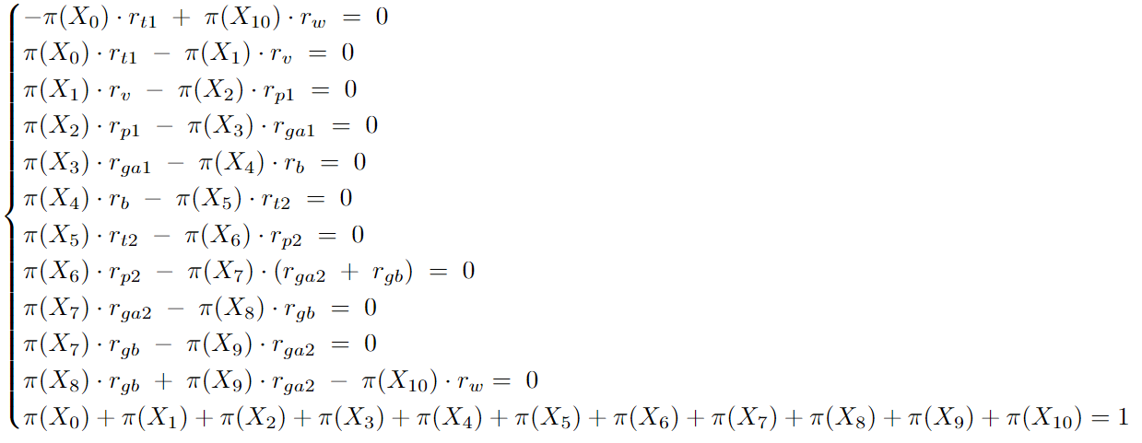
Global balance equations
Notes:
in order to compute steady state

Slide 37
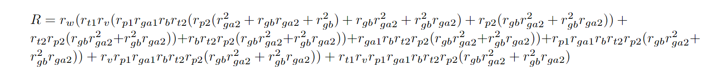
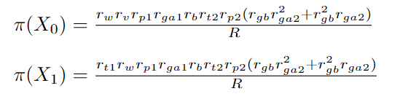
Steady state distribution
Notes:
For every time-homogeneous, finite, irreducible Markov process with state space S, there exists a steady state probability distribution
Steady state represents the probability to be in a particular state.

Slide 38
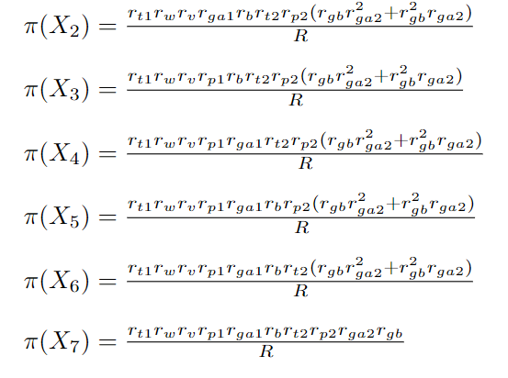
Steady state probabilities

Slide 39
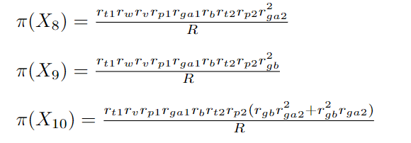
Steady state probabilities

Slide 40
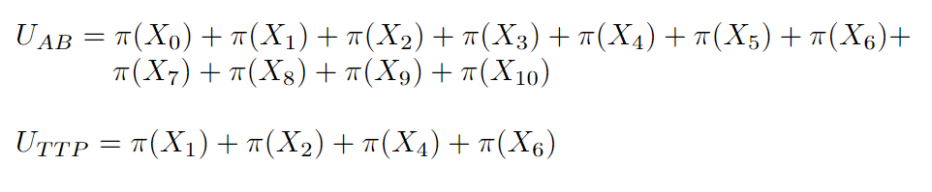
Utilisation
Notes:
state based

Slide 41
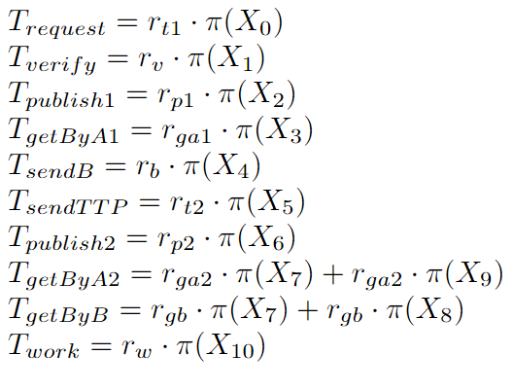
Throughput
Notes:
rate based

Slide 42
PEPA Eclipse Plug-in

Slide 43
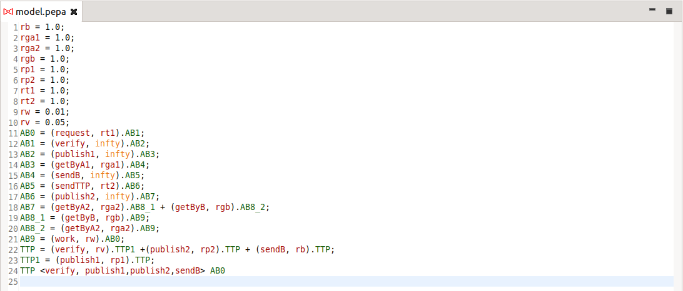
Pepa Model

Slide 44
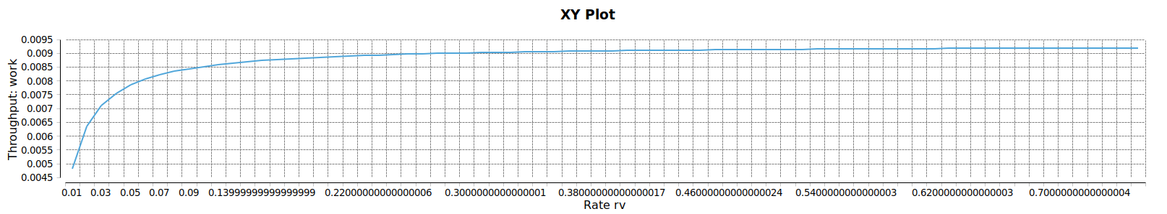
Experimentation

Slide 45
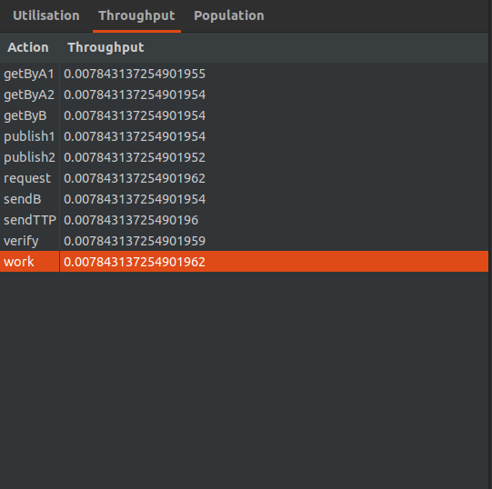
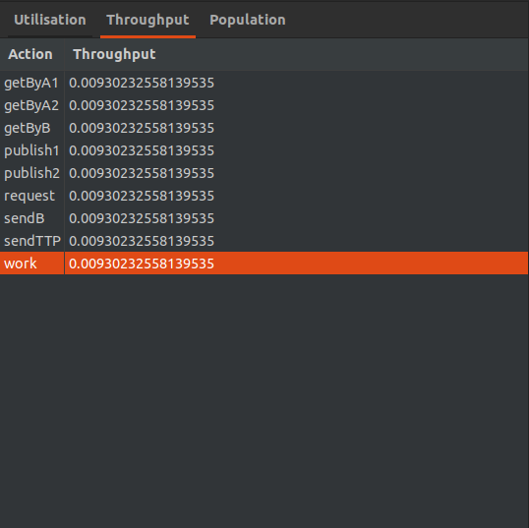
Throughput Variation
Our model
Original model

Slide 46
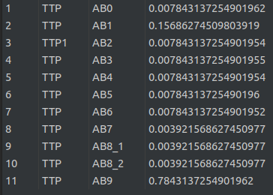
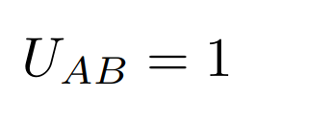
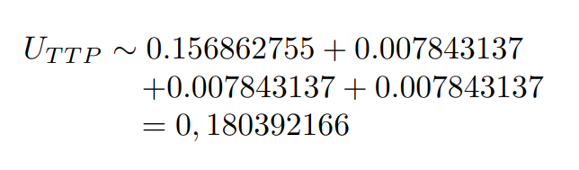
Utilisation
Steady state probabilities
Utilisation

Slide 47
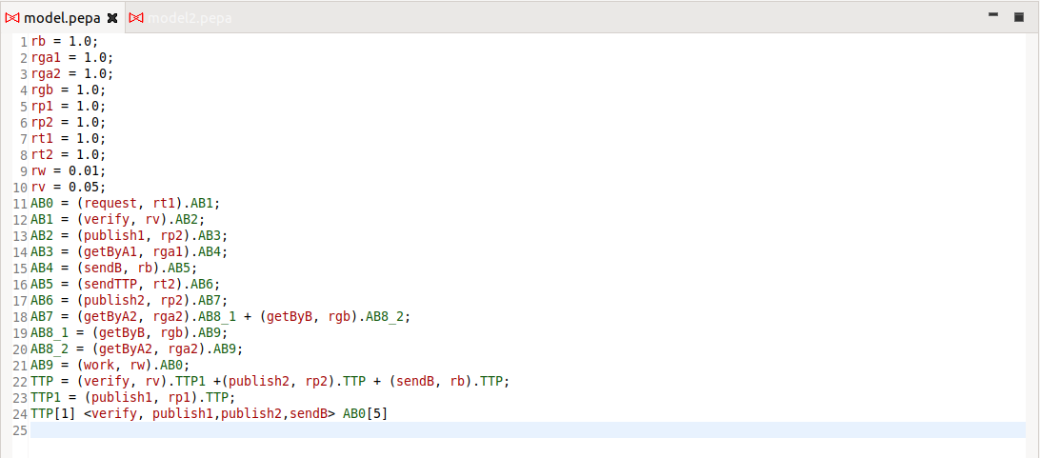
More clients

Slide 48
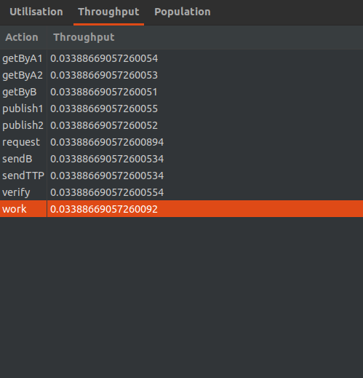
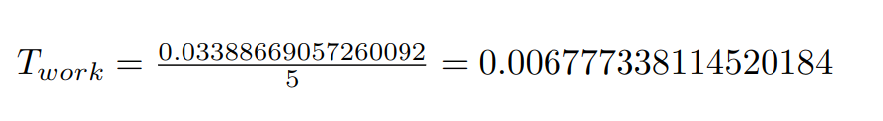

Throughput
Total throughput
Throughput of multi-client
Throughput of single-client

